Slide 1

Welcome to SUMO 2019
Simulating Connected Urban Mobility
May 13th – 15th
Berlin - Adlershof

Slide 2
SUMO 2019 Program
Monday, May 13th
12:00-13:00 Welcome and Registration
13:00-14:00 openMobility (Robert)
14:00-15:30 SUMO Tutorial (Jakob)
16:00-17:45 Ask-Us-Anything (Micha)
18:00-18:30 Social Event (Visit Co-Generation-Plant, Group 1)
18:30-19:00 Social Event (Visit Co-Generation-Plant, Group 2)
19:30 Restaurant (Laura)

Slide 3
SUMO Tutorial
Jakob Erdmann
SUMO2019, Berlin

Slide 4
DLR.de • Chart 4
SUMO2016 > Jakob Erdmann • SUMO Tutorial > 2016-05-23
Outline
Prerequisites
3-Click scenario generation with osmWebWizzard.py
Network editing
Visualizing traffic properties
Public transport and intermodal routing
Visual (!) demand editing
Parking
Netgenerate

Slide 5
DLR.de • Chart 5
SUMO2016 > Jakob Erdmann • SUMO Tutorial > 2016-05-23
Prerequisites
SUMO 1.2.0 or latest development version sumo.dlr.de/wiki/Downloads
Python: www.python.org/download/releases/2.7/
Text Editor (i.e. notepad-plus-plus.org/ )
Data files: sumo.dlr.de/daily/sumo2019_tutorial.zip
Tutorial files and latest SUMO development version (recommended) are included on the conference USB-drive

Slide 6
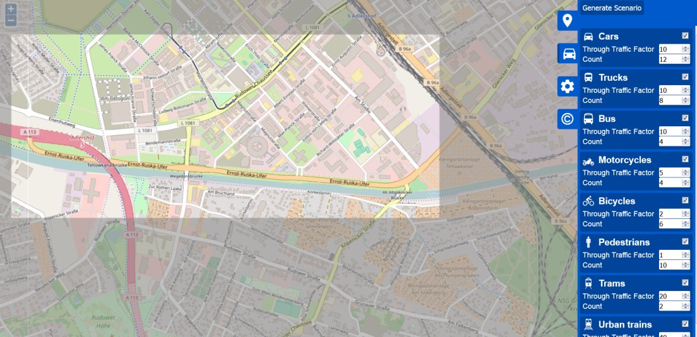
DLR.de • Chart 6
SUMO2016 > Jakob Erdmann • SUMO Tutorial > 2016-05-23
osmWebWizzard
Getting a basic scenario with tools/osmWebWizzard.py
Mode-specific network options
Random traffic
Configure
Area
Traffic modes
Traffic volume
Fraction of through-traffic
Public Transport
Generated files allow rebuilding and adapting the scenario
Sample data in 0_adlershof_wizard

Slide 7
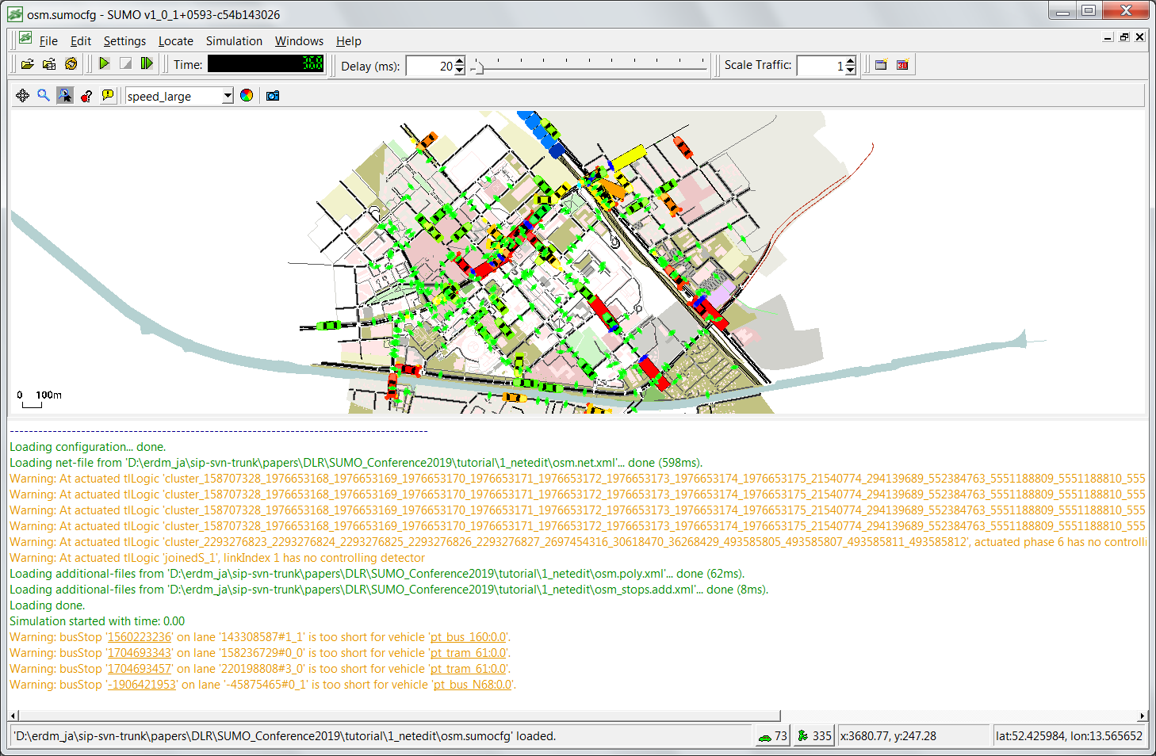
DLR.de • Chart 7
SUMO2016 > Jakob Erdmann • SUMO Tutorial > 2016-05-23
Generated Simulation

Slide 8
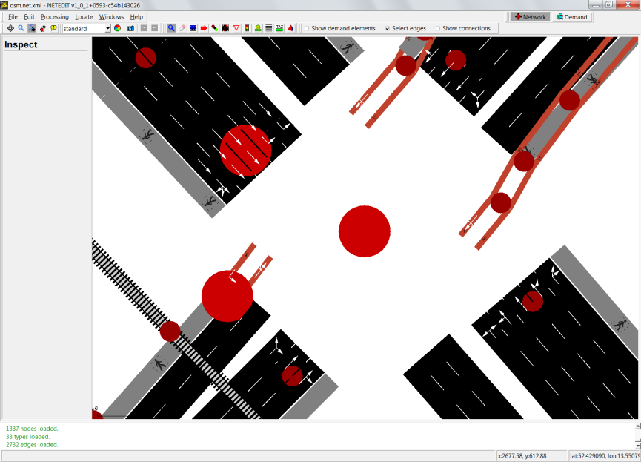
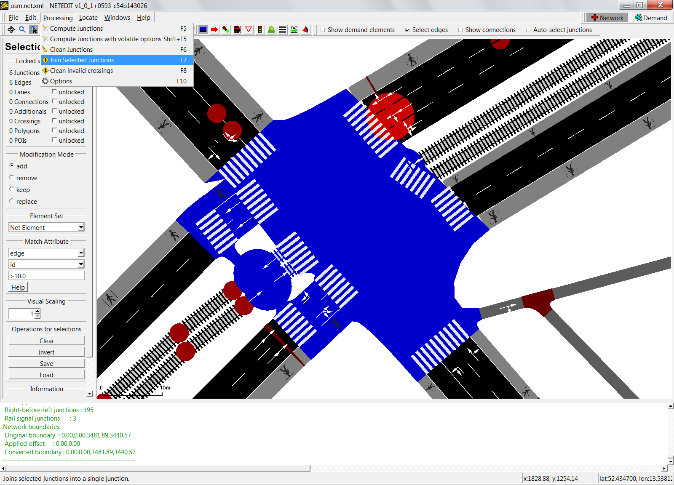
DLR.de • Chart 8
SUMO2016 > Jakob Erdmann • SUMO Tutorial > 2016-05-23
Fixing network problems
Superfluous edges causing warnings at actuated traffic light -> delete
Remove superfluous crossings
Replace Junction by geometry-point ahead of tls-controlled intersection
Recreate TLS (cosmetics)
Set descriptive phase names
Join junction clusters
Reconstruct pedestrian crossings
Fix connections (optionally recreate TLS)
run build.bat to adapt traffic to changes (edges removed by joining)
On Windows, sumo-gui must be closed!
Sample data in 1_netedit

Slide 9
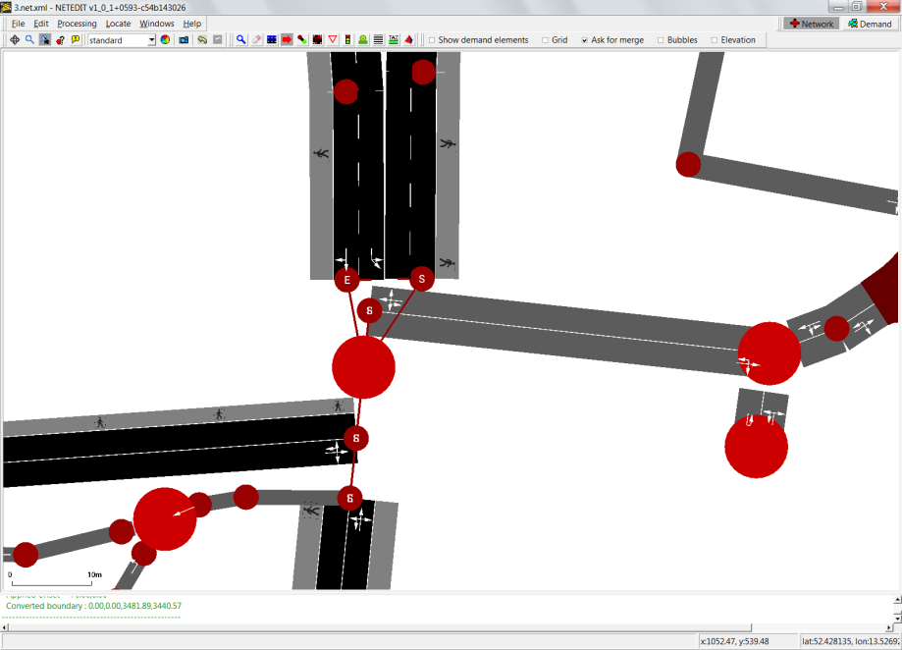
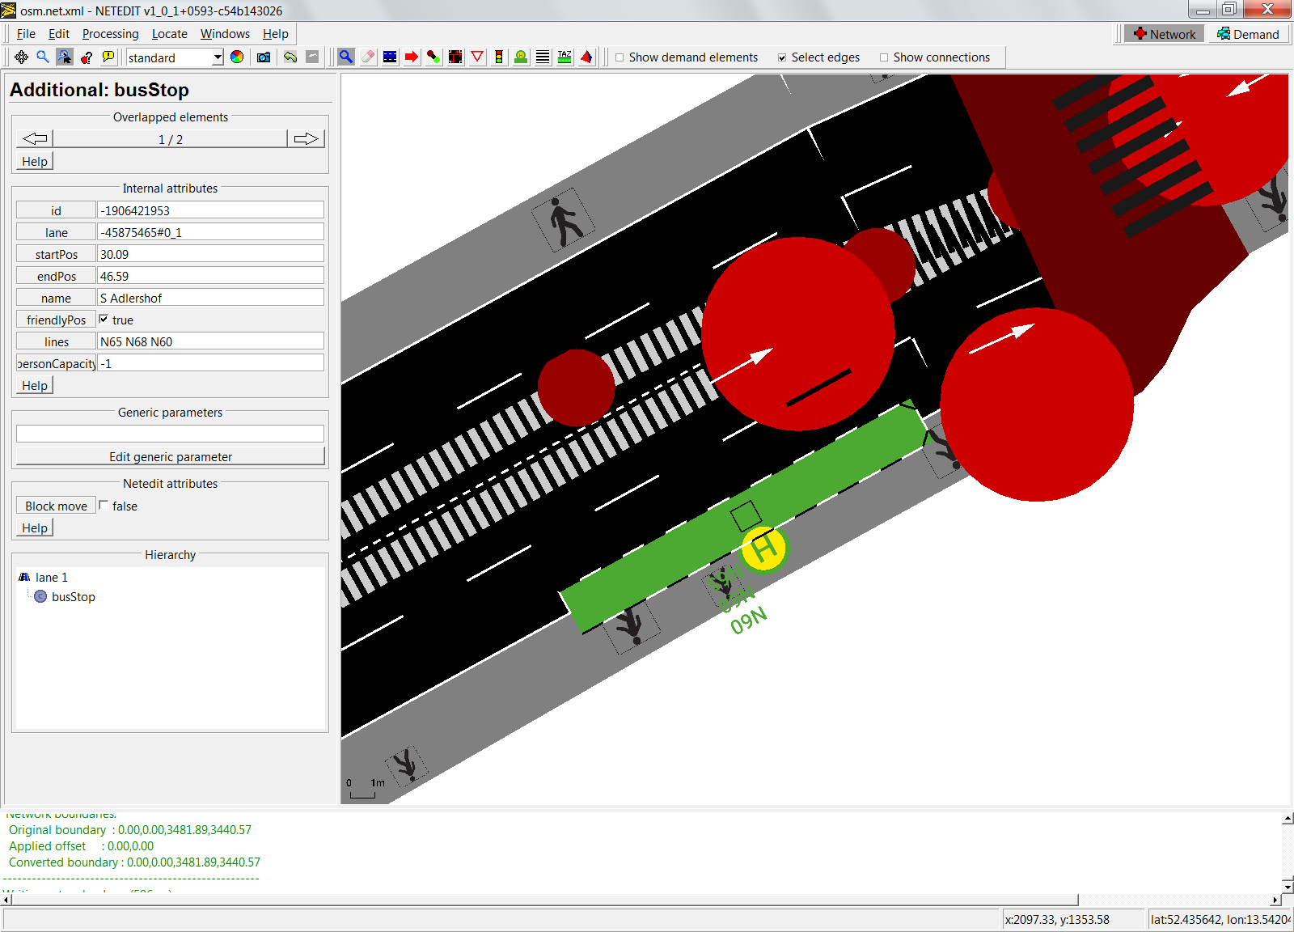
DLR.de • Chart 9
SUMO2016 > Jakob Erdmann • SUMO Tutorial > 2016-05-23
Fixing network problems (2)
Adapt traffic light plan to avoid conflict between turning vehicles and pedestrians (causes warning about missing detector for actuated TLS)
Bad Junction shape causing insufficient space for busStop
Move geometry endpoints
Edit remaining busStops directly
Move edge
Move busStop
Inspect/edit attributes
Sample data in 1_netedit.final
Sample data in 1_netedit

Slide 10
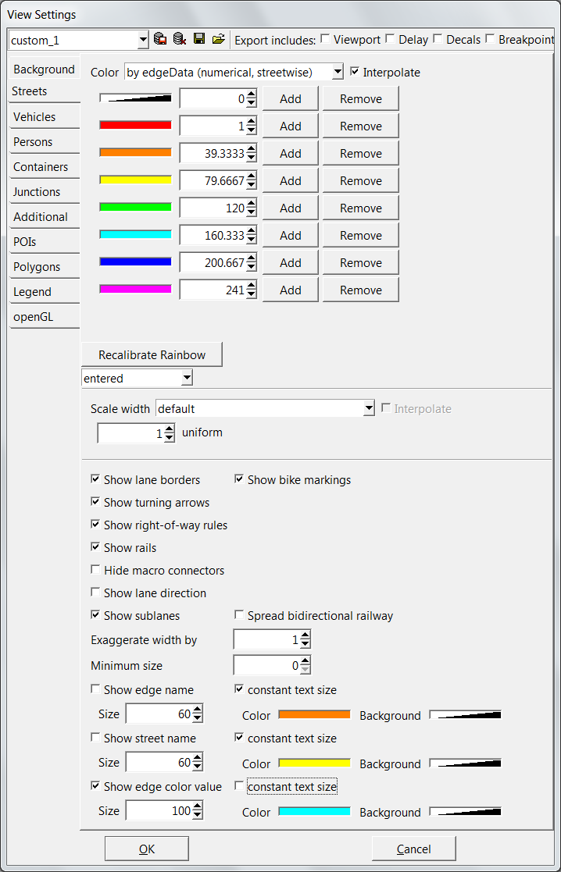
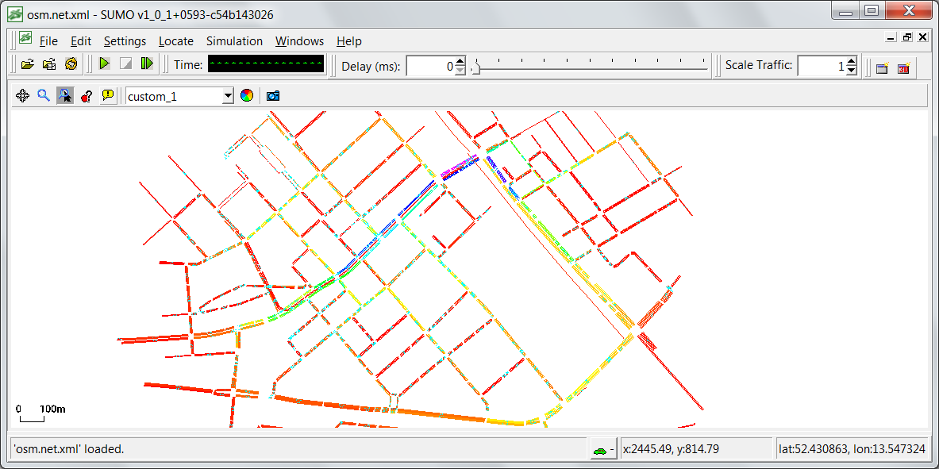
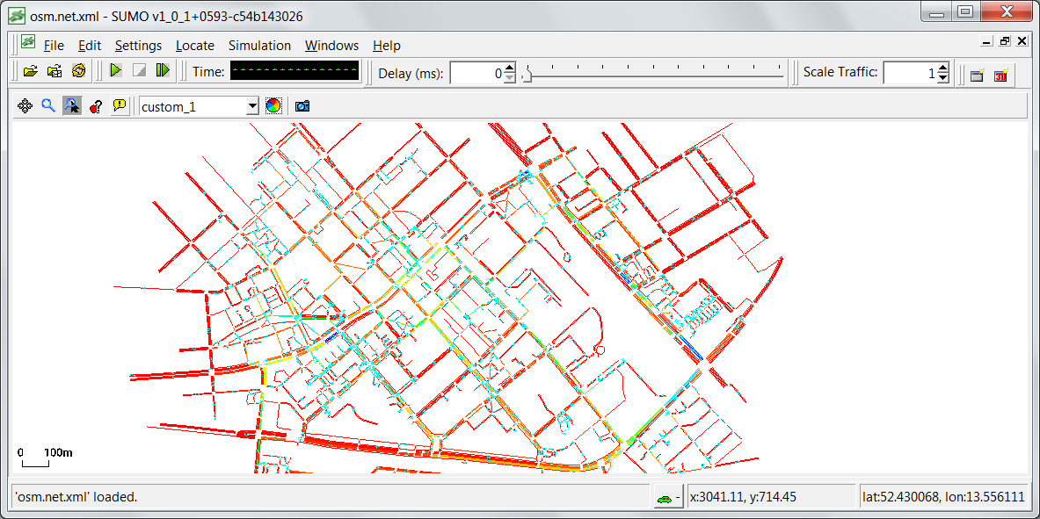
DLR.de • Chart 10
SUMO2016 > Jakob Erdmann • SUMO Tutorial > 2016-05-23
Visualizing Traffic Data
edgeData
<edgeData id="pedData" file="edgeData_peds.xml" detectPersons="walk"/>
Load directly in sumo-gui
Sample data in 1_netedit

Slide 11
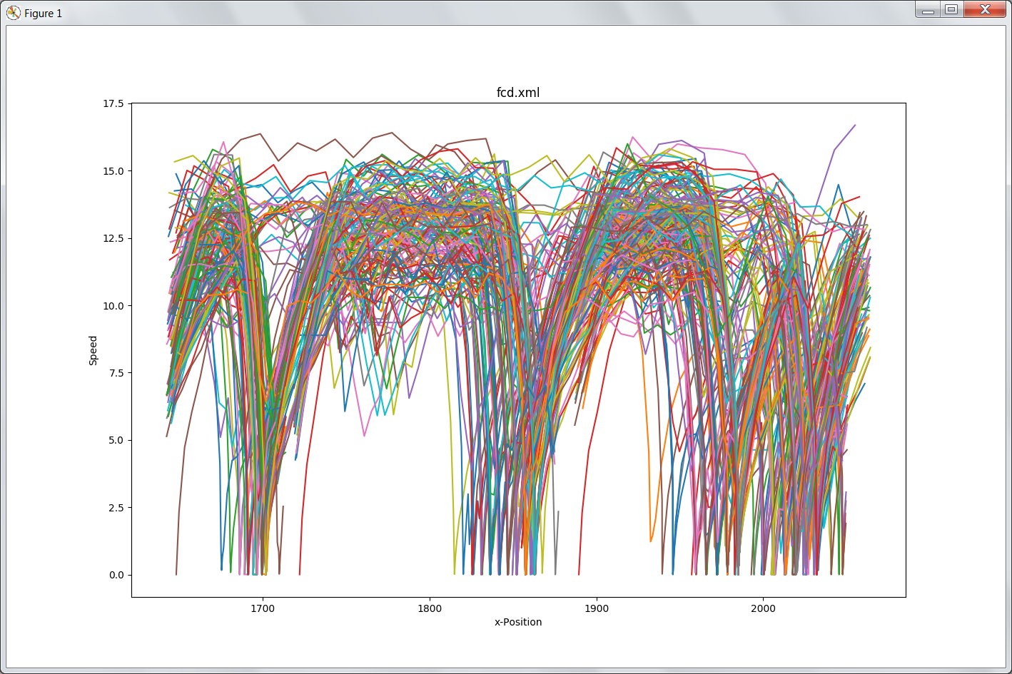
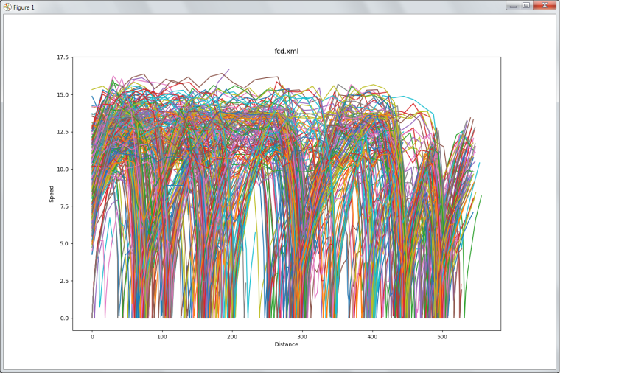
DLR.de • Chart 11
SUMO2016 > Jakob Erdmann • SUMO Tutorial > 2016-05-23
Visualizing Trajectories
Filtered FCD-output
--fcd-output.filter-edges.input-file edges.txt
python %SUMO_HOME%\tools\plot_trajectories.py fcd.xml -t xs -s
Sample data in 2_visualization

Slide 12
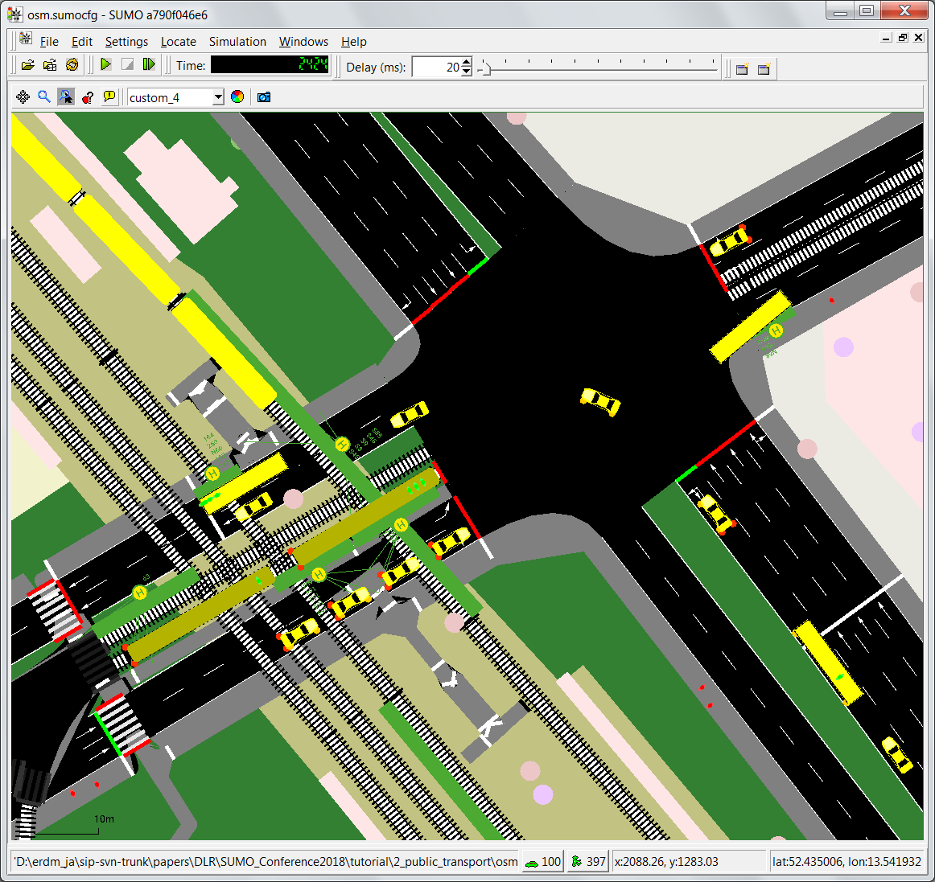
DLR.de • Chart 12
SUMO2016 > Jakob Erdmann • SUMO Tutorial > 2016-05-23
Public Transport
NETCONVERT can import public transport data from OSM:
Stops (--ptstop-output)
Lines (--ptline-output)
webWizard uses this information to automatically generate public transport schedules (using tools/ptlines2flows.py)
Simulates one vehicle per line to record stopping times
service period import from OSM
Note: Version 1.2 still includes all lines regardless of day/night service. Fixed in dev-version
Generated pedestrians demand (actually <personTrip>) automatically performs intermodal routing to decide between walking and public transport

Slide 13
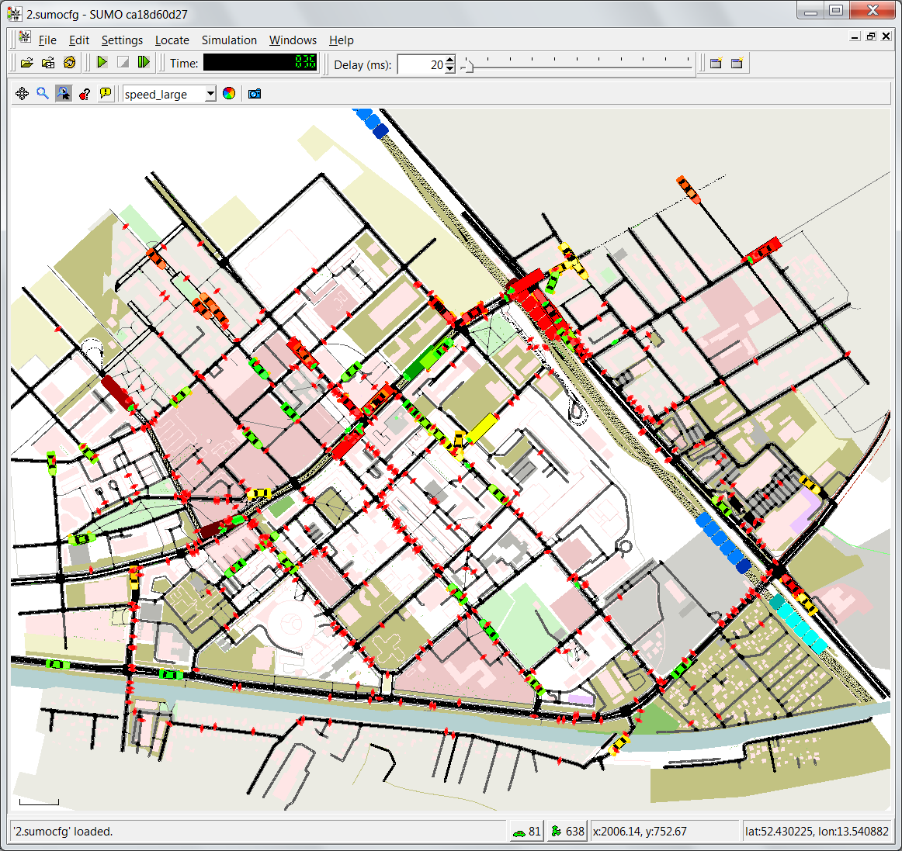
DLR.de • Chart 13
SUMO2016 > Jakob Erdmann • SUMO Tutorial > 2016-05-23
Adapting Public Transport
Warning: Person 'ped3260' aborted waiting for 164:1 at busStop '1383533459
Look at that person in detail -
View parameters and plan, exaggerate selected person size
missed the bus by only a few seconds
Static intermodal routing unaware of individual speed
Increase service end from 3600 to 5400 in build.bat
Alternative: load personTrips directly into the simulation
randomTrips may create disconnected trips so we need to filter those first
duarouter -c validatePersons.duarcfg
Better Plans: 4 aborted instead of 12
Note: Works only in dev-version
Sample data in 3_public_transport.final

Slide 14
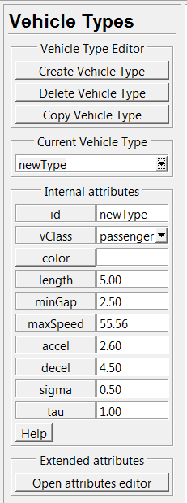
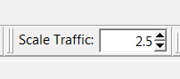
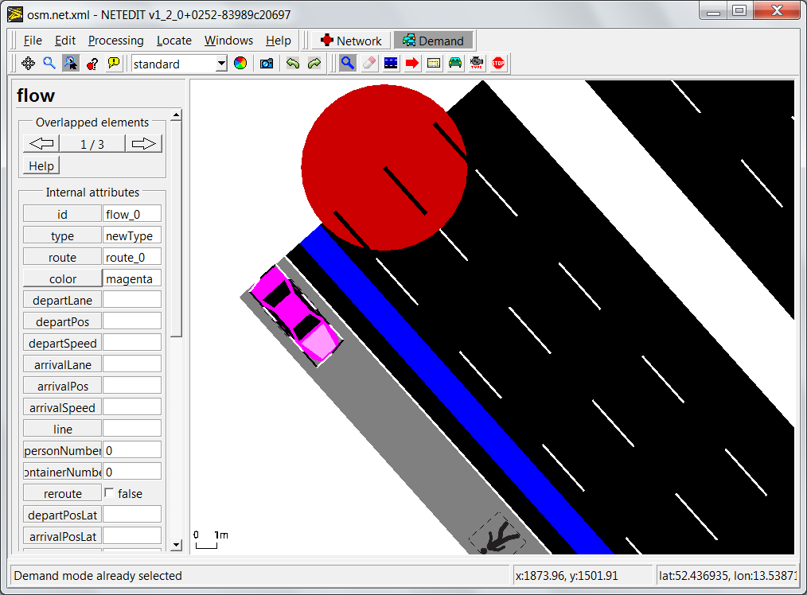
DLR.de • Chart 14
SUMO2016 > Jakob Erdmann • SUMO Tutorial > 2016-05-23
Visual Demand Editing
Sumo option --scale
Netedit demand mode! (F4)
Create Route
Create Vehicle Type
Create Flow (by clicking on Route)
Save demand
Version 1.2 issues
Create route from non-consecutive edges
Saving Flow
...

Slide 15
Visual Demand Editing - Outlook
Bugfixing (obviously)
Usability
Overlapping Objects
Understanding / Manipulating large demand files
Features
Persons
<personFlow id="pflow" begin="0.00" end="3600.00" number="1000">
<personTrip from="EDGE1" to="EDGE2" modes="public"/>
</personFlow>
Sample data in 4_demand.final

Slide 16
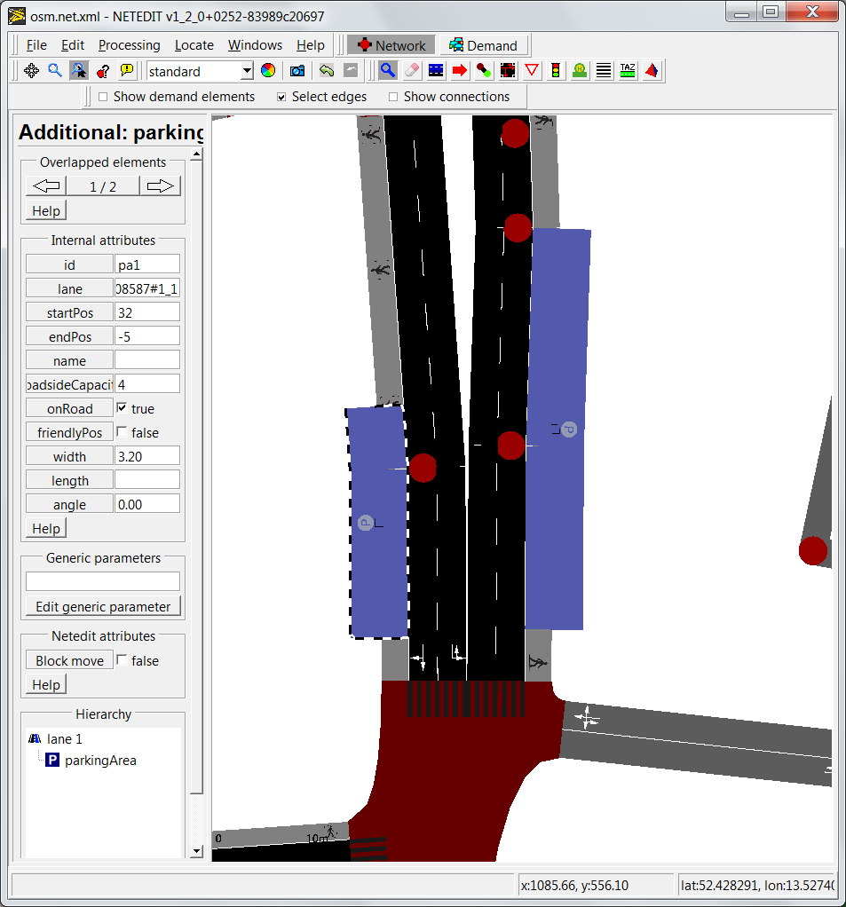
DLR.de • Chart 16
SUMO2016 > Jakob Erdmann • SUMO Tutorial > 2016-05-23
Parking
Define road-side parking (onRoad and road-side)
generateParkingAreaRerouters.py
(see buildRerouters.bat for parameters)
generate <parkingAreaReroute> to allow alternative parkingArea usage

Slide 17
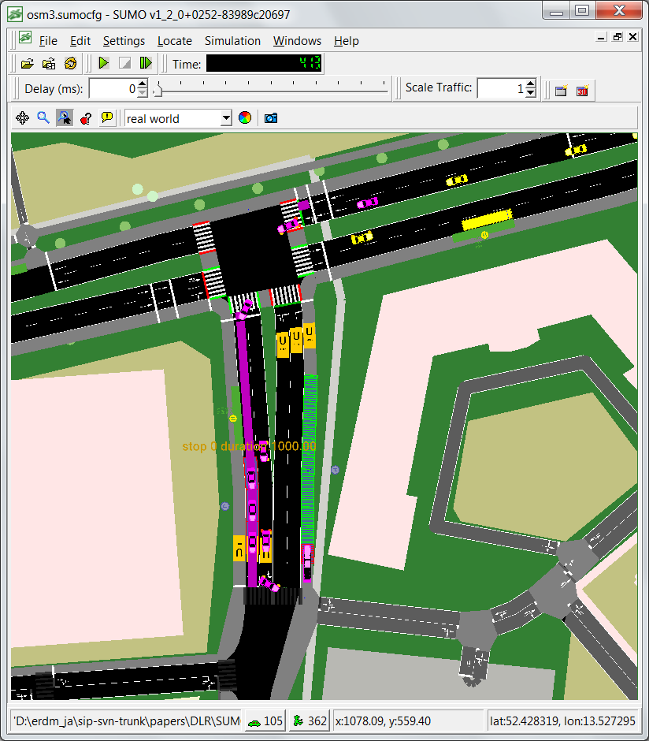
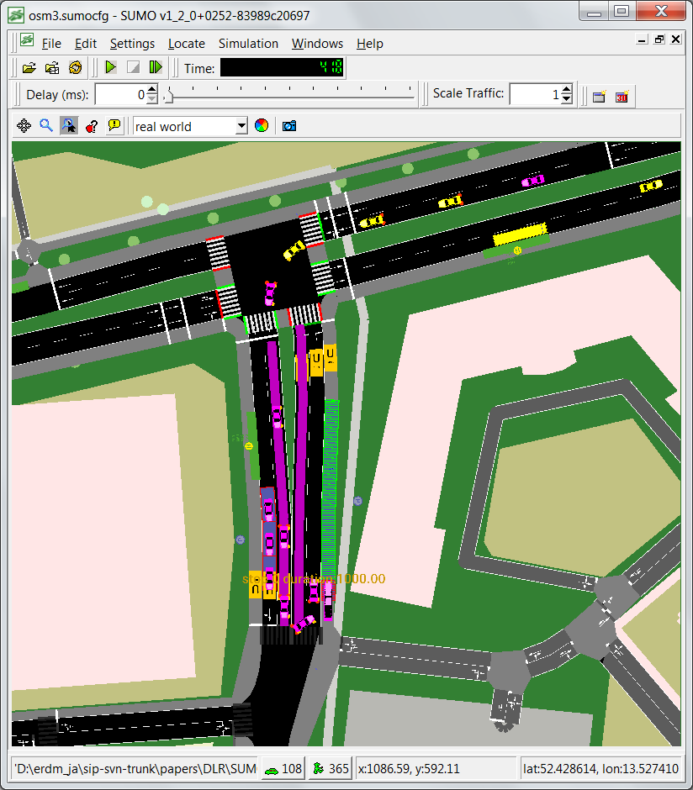
DLR.de • Chart 17
SUMO2016 > Jakob Erdmann • SUMO Tutorial > 2016-05-23
Parking - Dynamic rerouting
Sample data in 5_parking

Slide 18
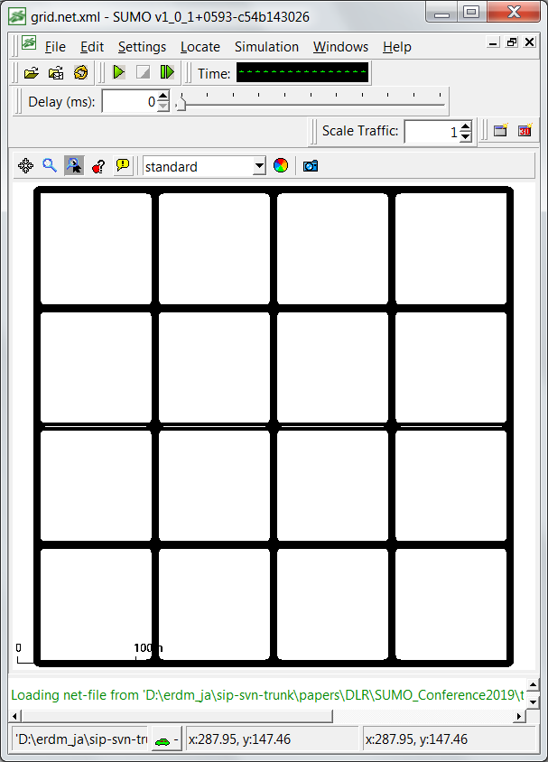
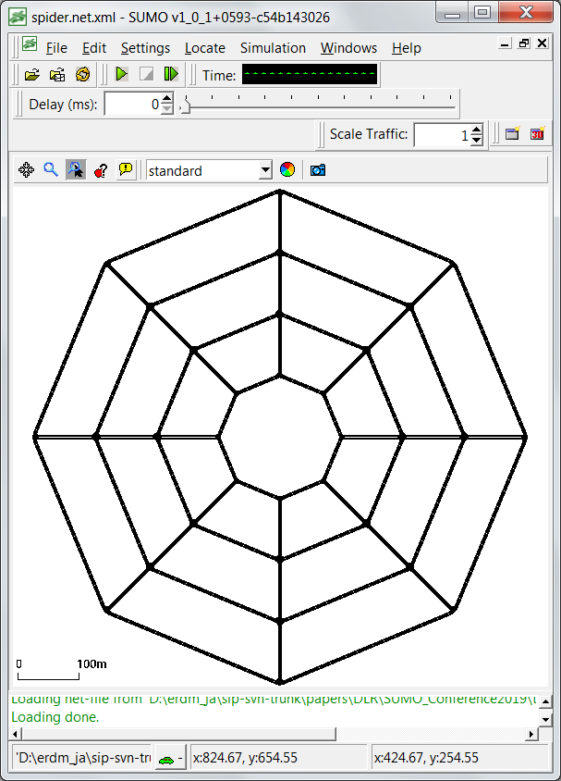
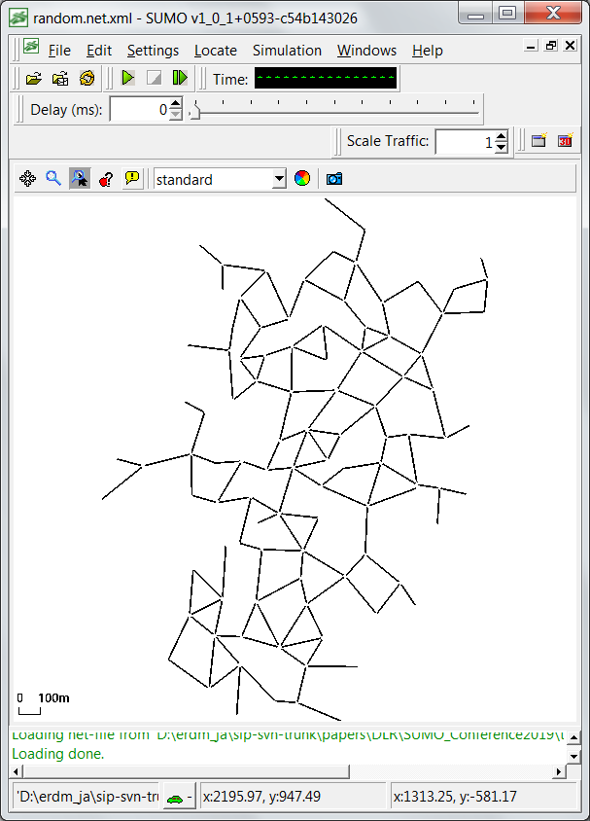
DLR.de • Chart 18
SUMO2016 > Jakob Erdmann • SUMO Tutorial > 2016-05-23
Netgenerate
Simple examples: Grid, Spider, Random
Sample data in 6_netgenerate

Slide 19
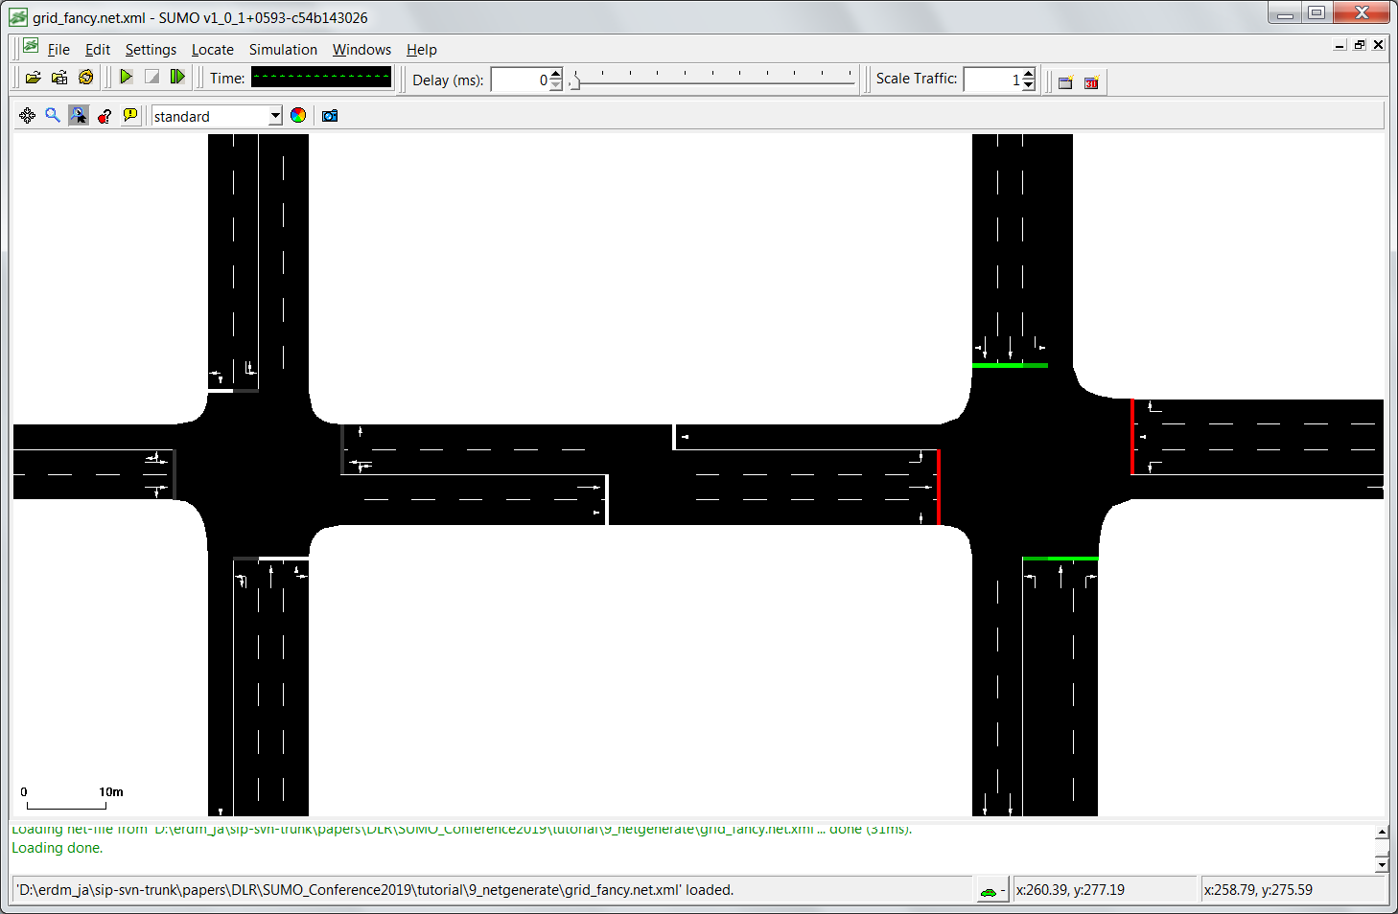
DLR.de • Chart 19
SUMO2016 > Jakob Erdmann • SUMO Tutorial > 2016-05-23
Netgenerate
New features: --turn-lanes --rand.random-lanenumber

Slide 20
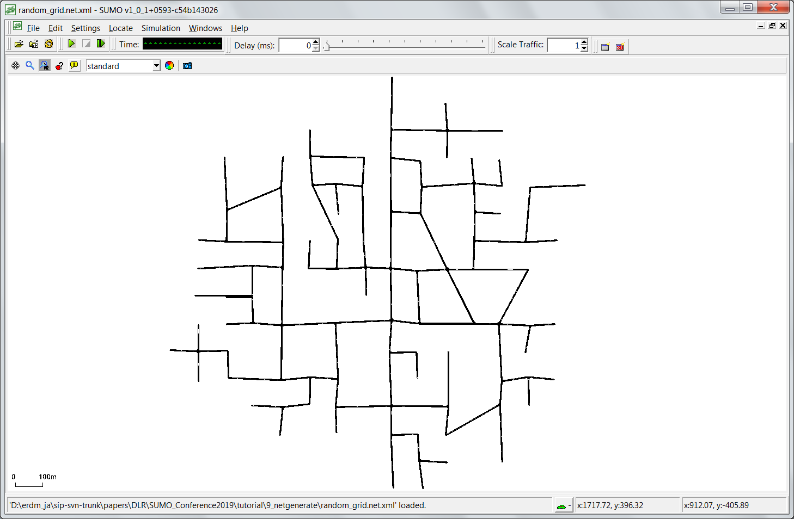
DLR.de • Chart 20
SUMO2016 > Jakob Erdmann • SUMO Tutorial > 2016-05-23
Netgenerate
New features: --random.grid --perturb-x --perturb-y --perturb-z

Slide 21
DLR.de • Chart 21
SUMO2016 > Jakob Erdmann • SUMO Tutorial > 2016-05-23
Conclusion
Use tools/osmWebWizzard.py to get a quick start
Read the documentation / FAQ at http://sumo.dlr.de/wiki
Report any bugs you find to sumo-user@eclipse.org
Share your scenarios and results
Talks to us. We are always looking for project partners! sumo@dlr.de

